Slide 1
Determining PMP for Florida-You Can’t Rely on HMR 51
Bill Kappel
Applied Weather Associates (AWA)
719-488-4311, billkappel@appliedweatherassociates.com

Slide 2

HMR Coverage

Slide 3
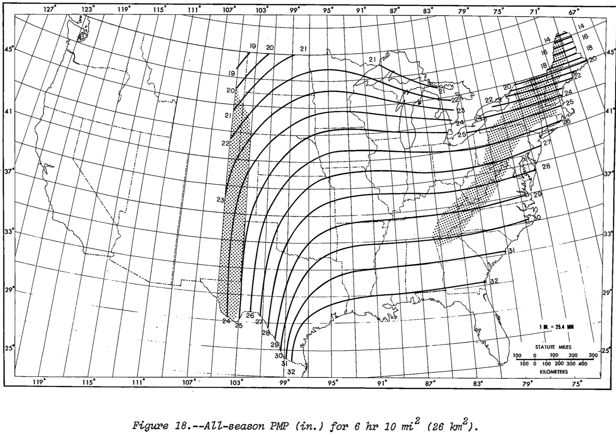
HMR 51 PMP Contours-6hr 10sqmi

Slide 4
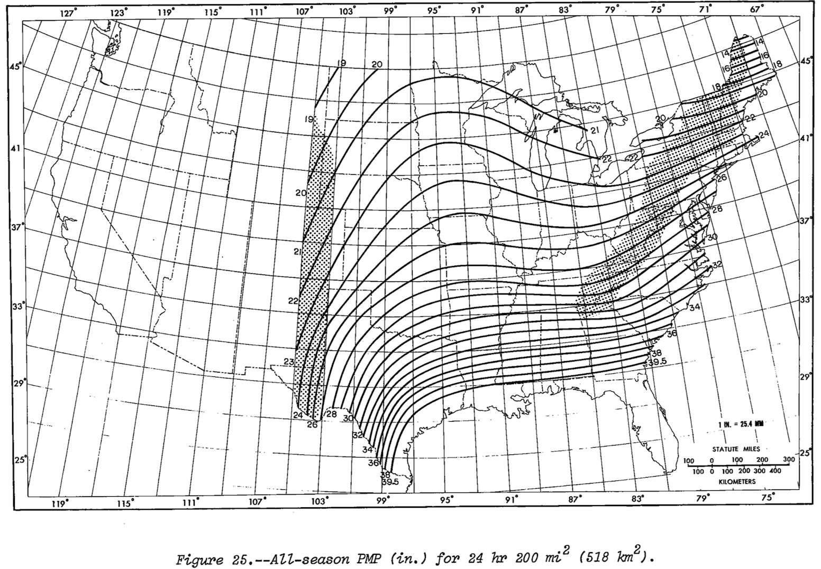
HMR 51 PMP Contours-24hr 200sqmi

Slide 5
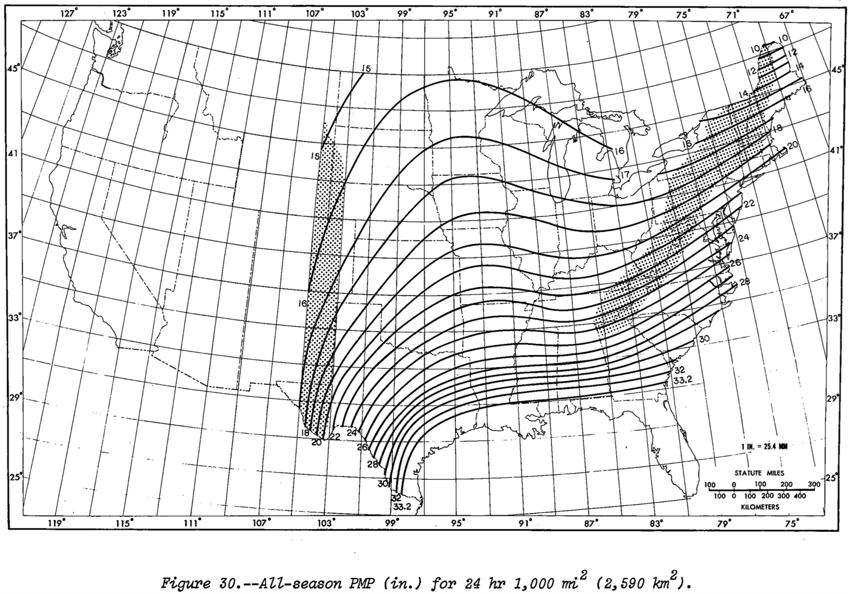
HMR 51 PMP Contours-24hr 1000sqmi

Slide 6
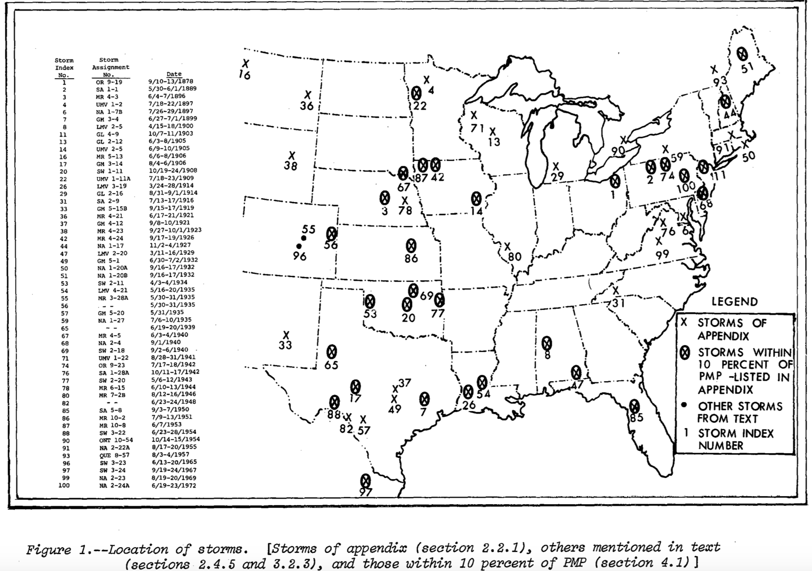
HMR 51 Storm Locations

Slide 7
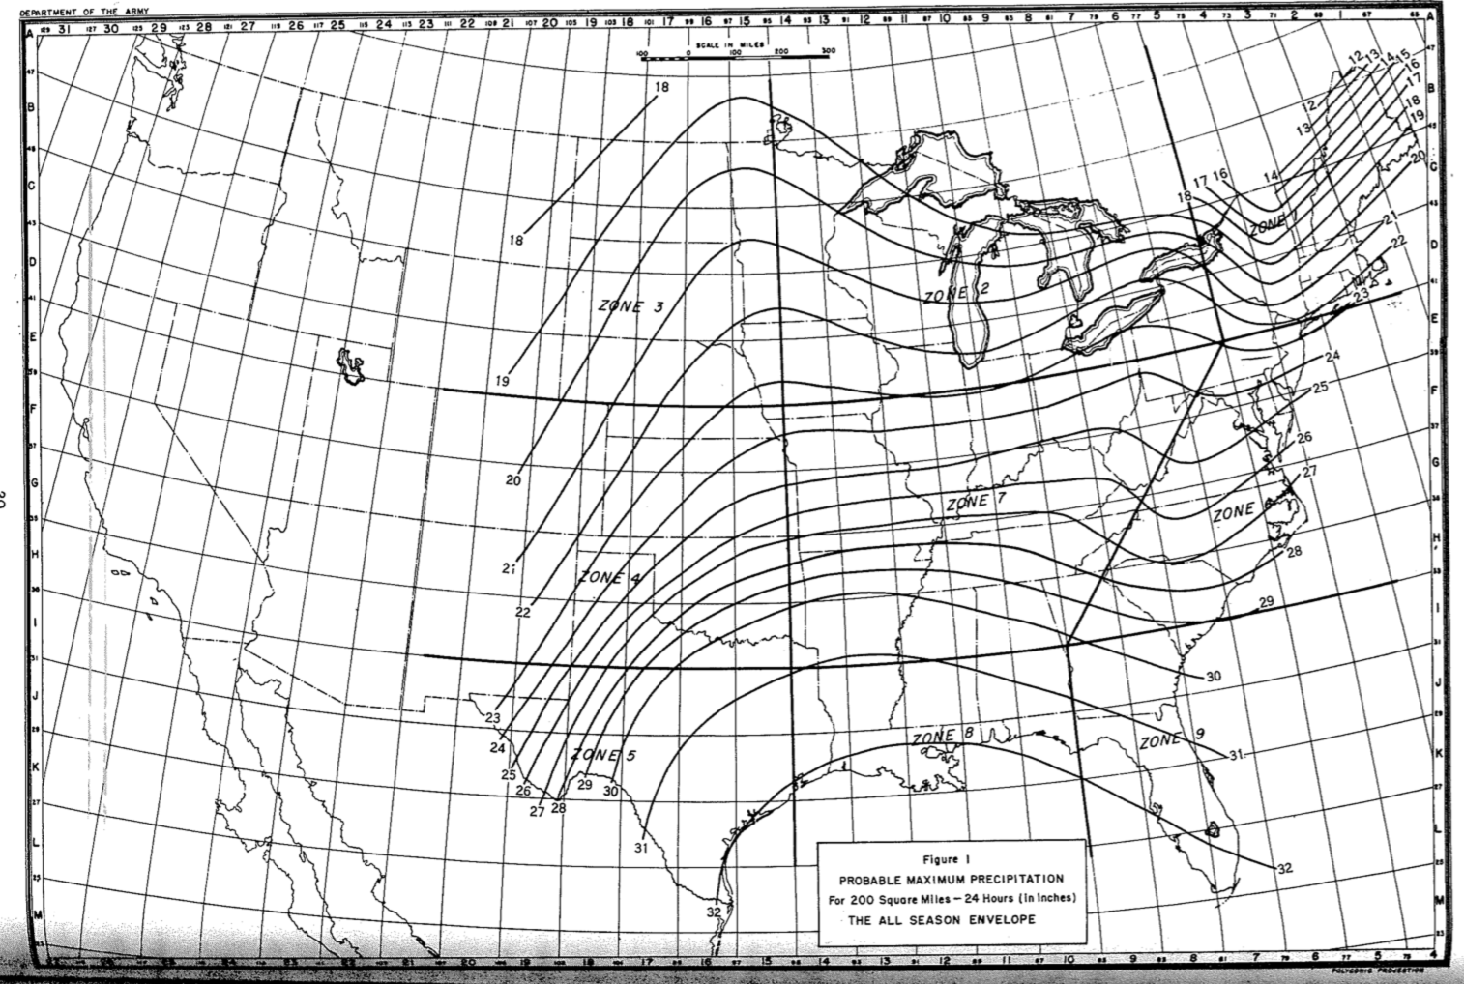
HMR 33 Can Save The Day?

Slide 8
HMR 33 Can Save The Day?
Published in 1956
Does NOT include Yankeetown, FL 1950 storm
Nearly 70 years of storm data and science not included

Slide 9
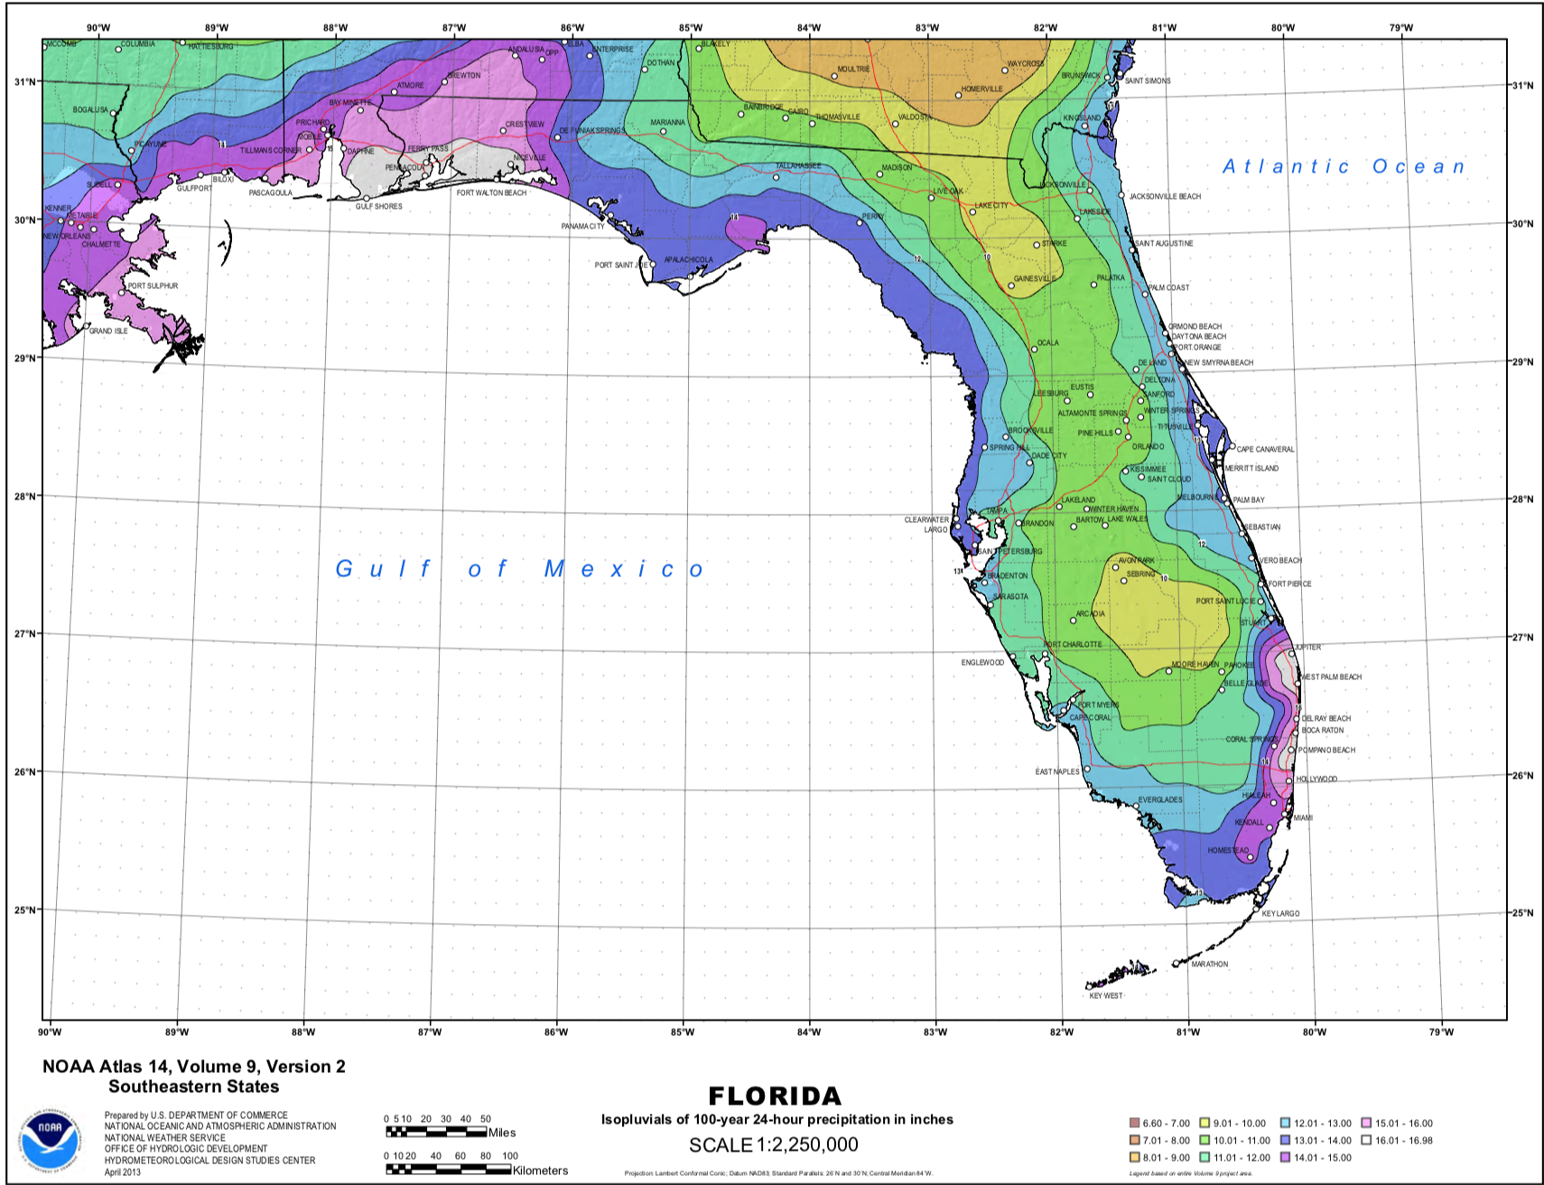
NOAA Atlas 14-Florida

Slide 10
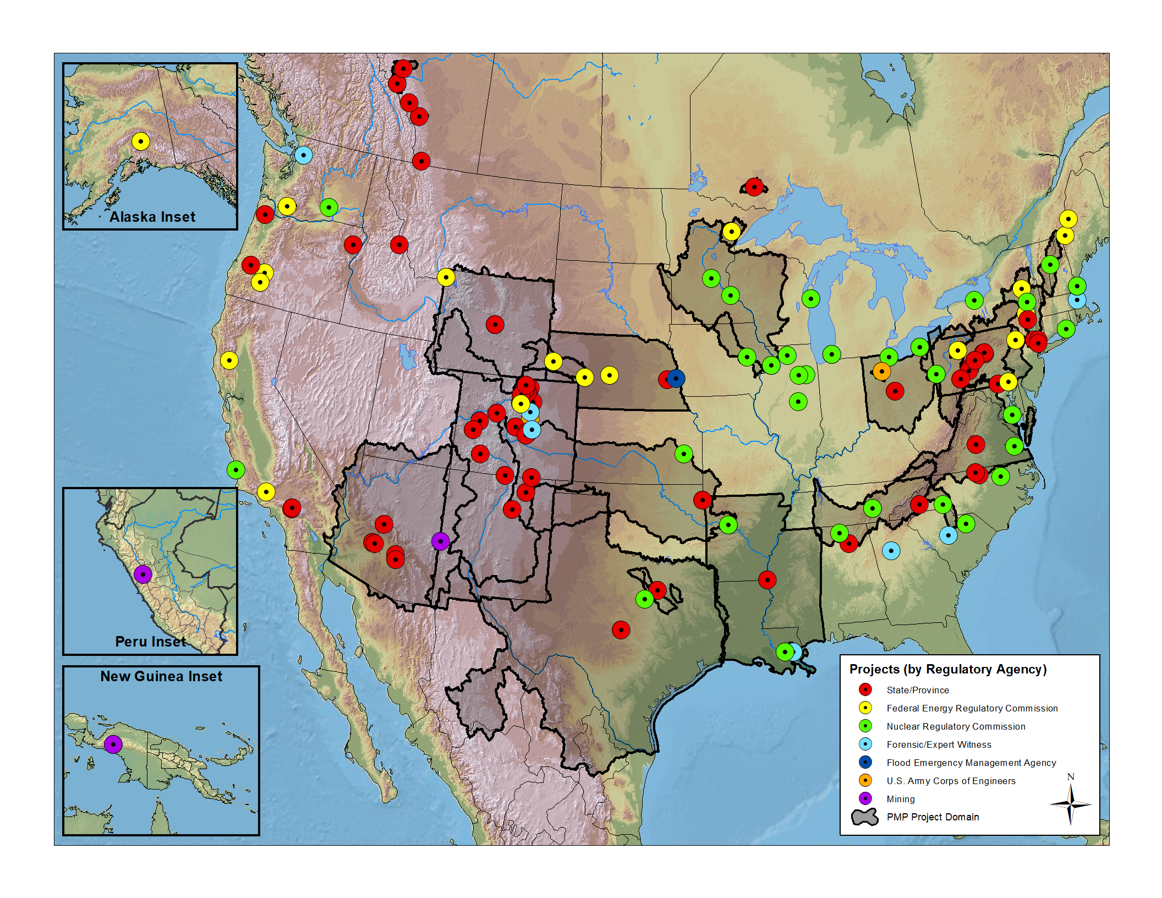
AWA PMP Development Coverage

Slide 11
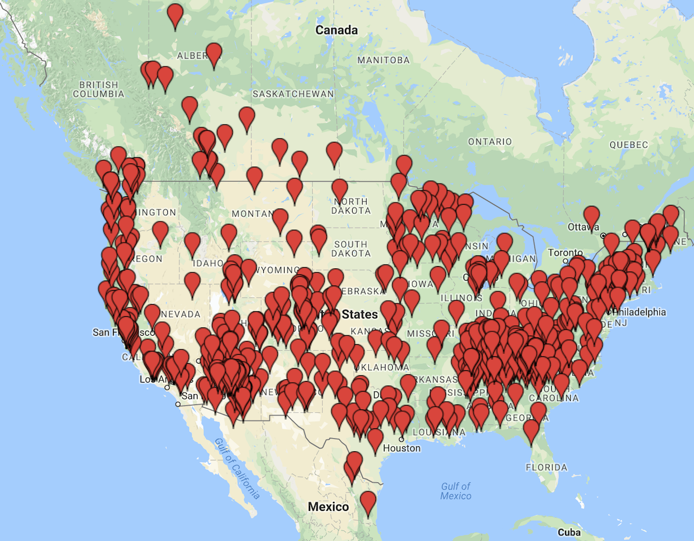
SPAS Storm Analyses Locations

Slide 12
Next Steps for Florida
Updated PMP estimates needed
        Update storm analyses
        Complete Annual Exceedance Probability

Slide 13
Next Steps for Florida
Florida DOES NOT have current PMP values
Updated PMP estimates needed
        Update storm analyses
                Significant infrastructure and lives at risk
                Storm data grossly out of date in Florida
Questions
Bill Kappel
719-488-4311
billkappel@appliedweatherassociates.com
www.appliedweatherassociates.com

